Slide 1

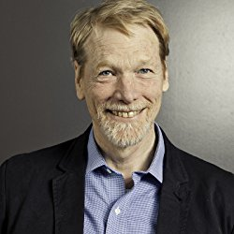

INTRAPRENEURSHIP; MORE THAN JUST A SPELLING MISTAKE
“a person within an existing organization who takes direct responsibility for turning an idea into a profitable finished product through assertive risk-taking and innovation.”
OK Mr Pinchot, what is an Intrapreneur?
‘Inventor’ of Intrapreneurship
Largest Network of Intrapreneurs
“a passionate individual, who thinks and acts like an entrepreneur, working inside a corporation or organisation, who develops and delivers innovative, profitable and sustainable solutions to social or environmental challenges”
And what is a “Social” Intrapreneur?

Slide 2




THE INTRAPRENEURSHIP EQUATION
Intrapreneurship = Innovation + People (+ Impact)
Woo!
Crowd Sourced, People Focused Innovation

